Slide 1
Energy in Design 2: Reducing Friction

Slide 2
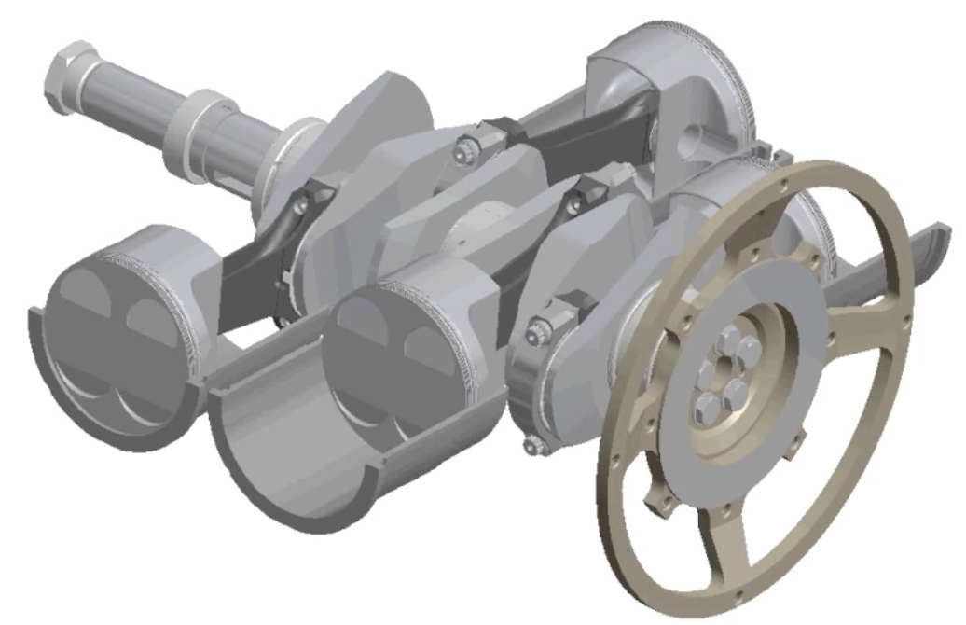
Friction

Slide 3
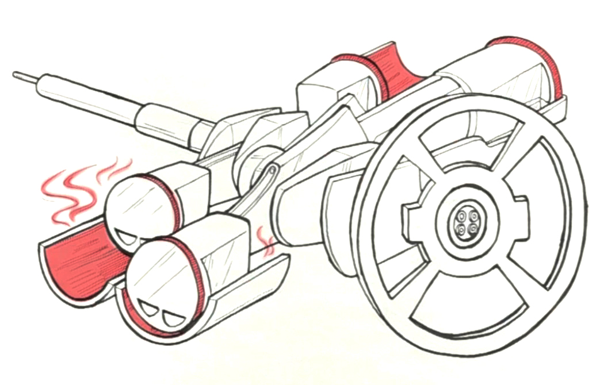
Friction
The pistons in a car engine lose thousands of watts of power to friction as they slide.
Notes:
heat, deformation, and wear

Slide 4
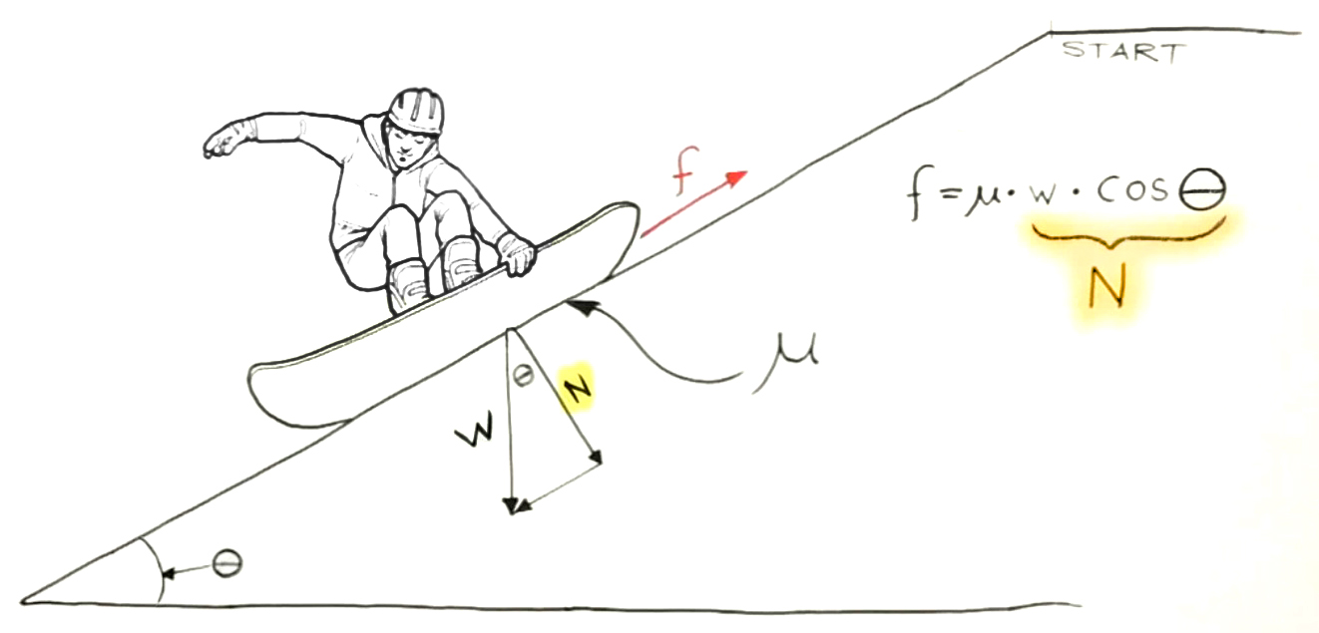
Friction

Slide 5
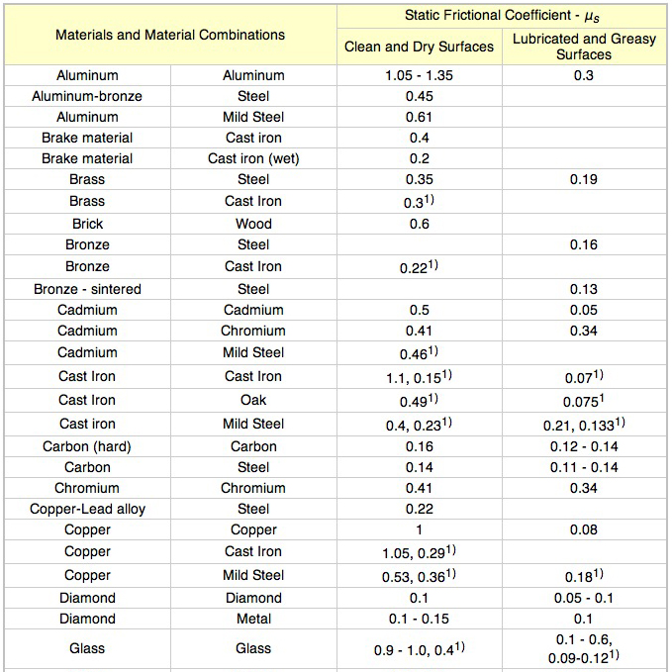
Friction Coefficients
from Engineeringtoolbox.com
Notes:
Note power DOES change based on speed.

Slide 6
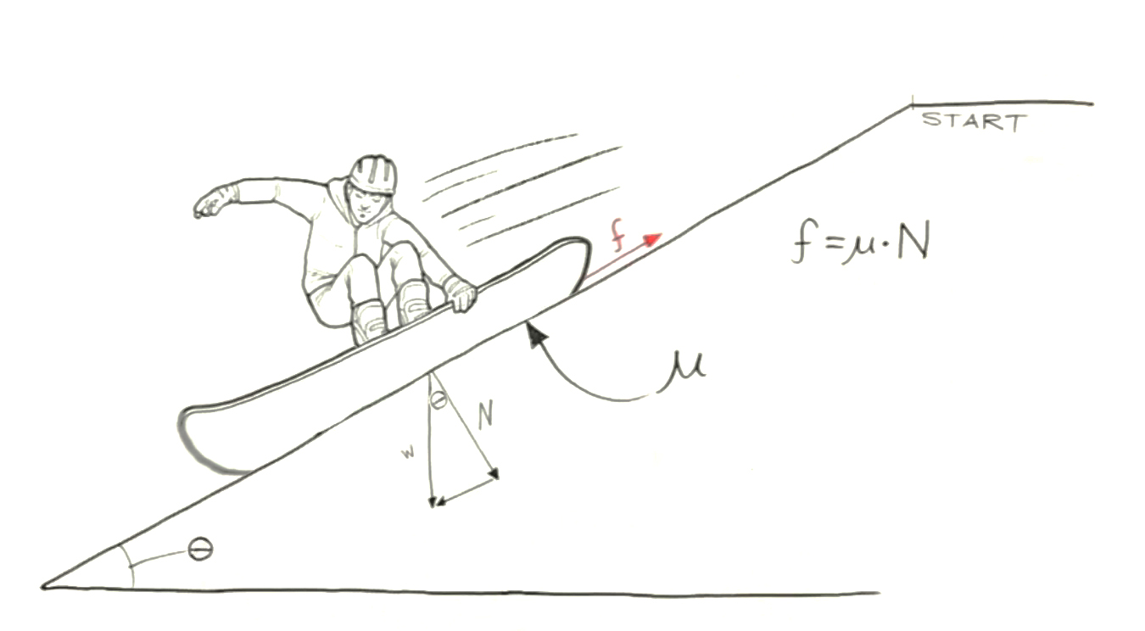
Friction vs. Speed & Area
Notes:
[Flip back & forth between this slide and the next slide to illustrate that friction doesn’t depend on speed or area]

Slide 7
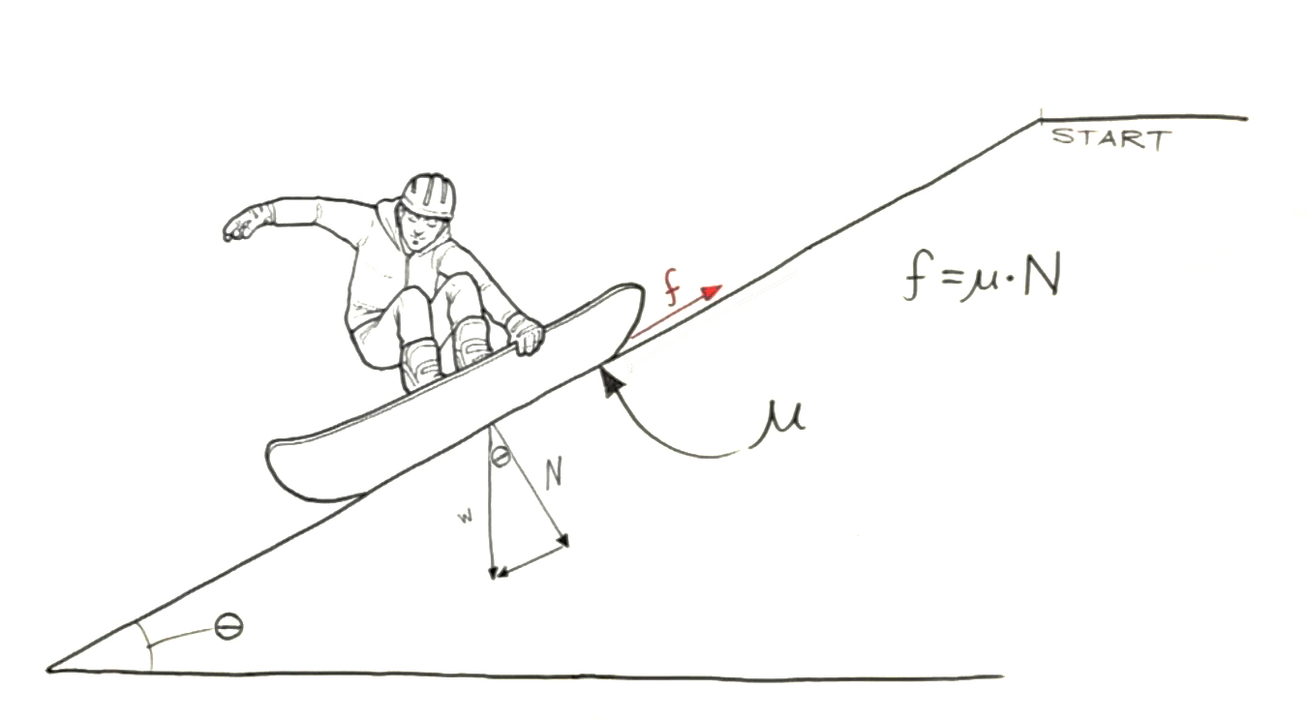
Friction vs. Speed & Area

Slide 8
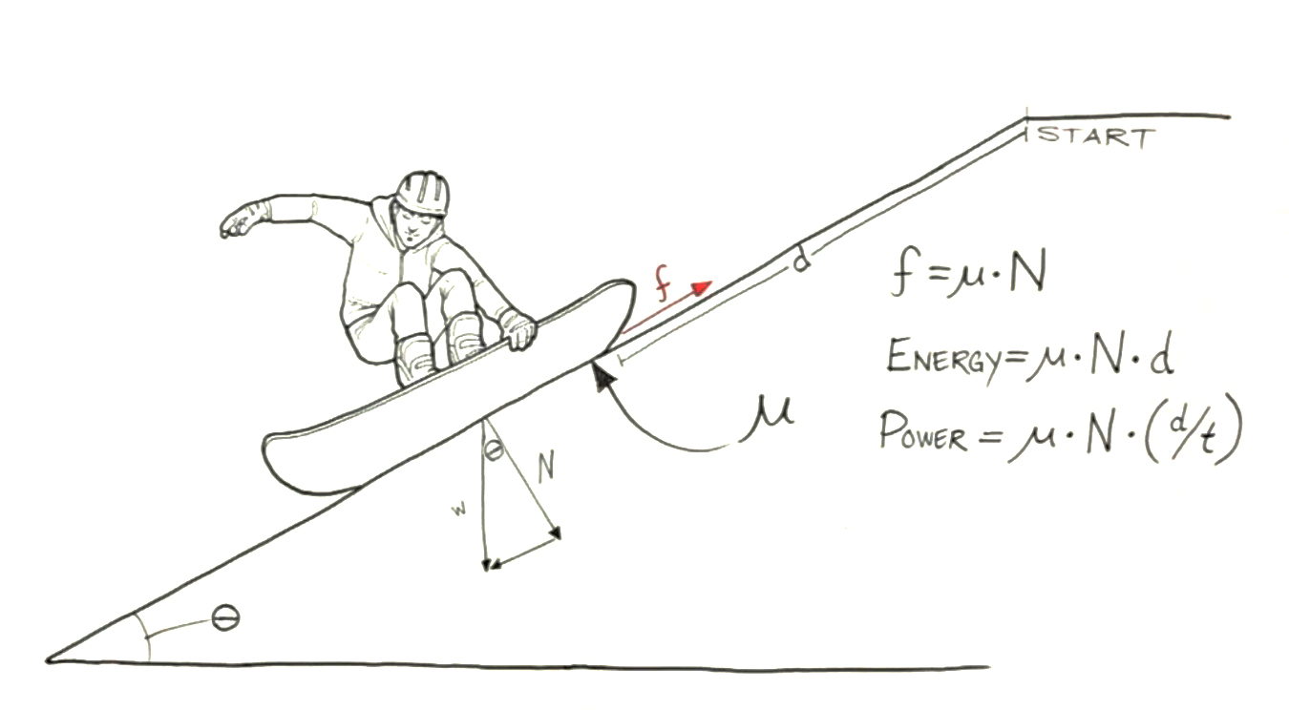
Friction Energy & Power
Notes:
Note power DOES change based on speed.

Slide 9
Modeling Friction Energy & Power
[Software]

Slide 10
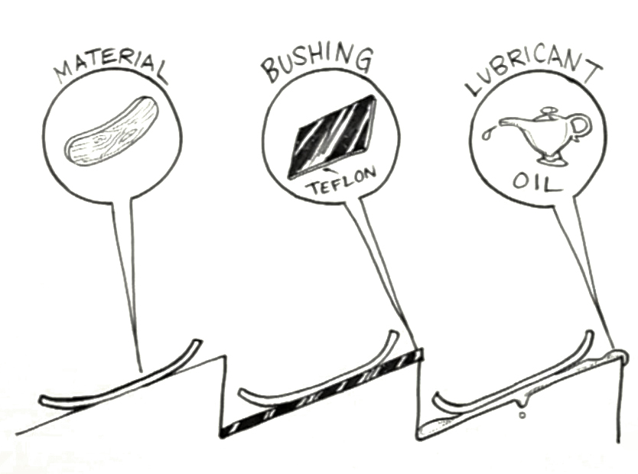
Reducing Friction
Notes:
“Material” includes surface roughness as well as material type.

Slide 11
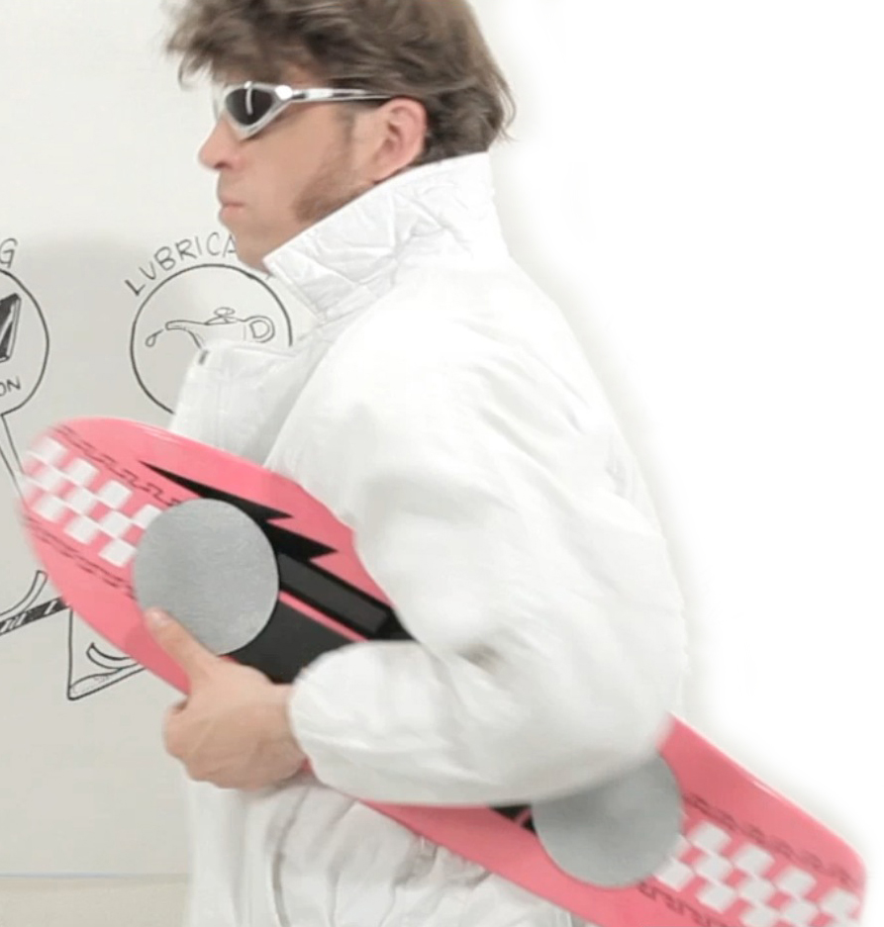
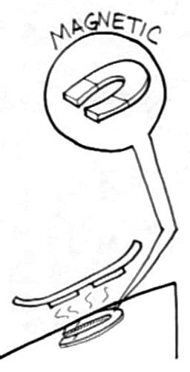
Reducing Friction

Slide 12
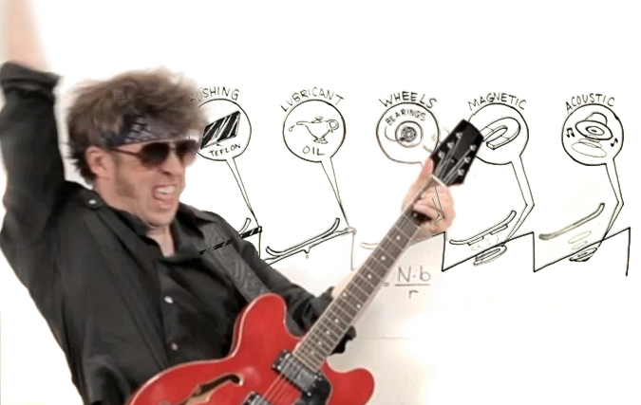
Reducing Friction

Slide 13
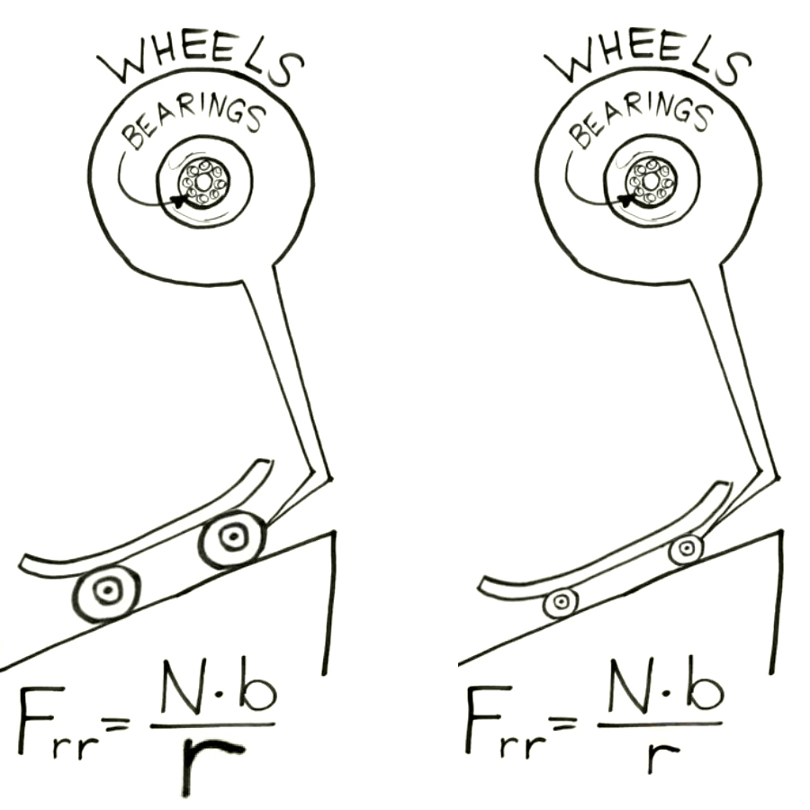
Rolling Resistance

Slide 14
Rolling Resistance
{
train (steel on steel): 0.002
bicycle tire on pavement: 0.005
truck tires on pavement: 0.007
car tires on pavement: 0.010

Slide 15
When Friction Is Good

Slide 16
Modeling Friction
[Software]

Slide 17
sustainabilityworkshop.autodesk.com

